Slide 1
DevOps on the Microsoft Stack
<name>
<title>
<email>

Slide 2
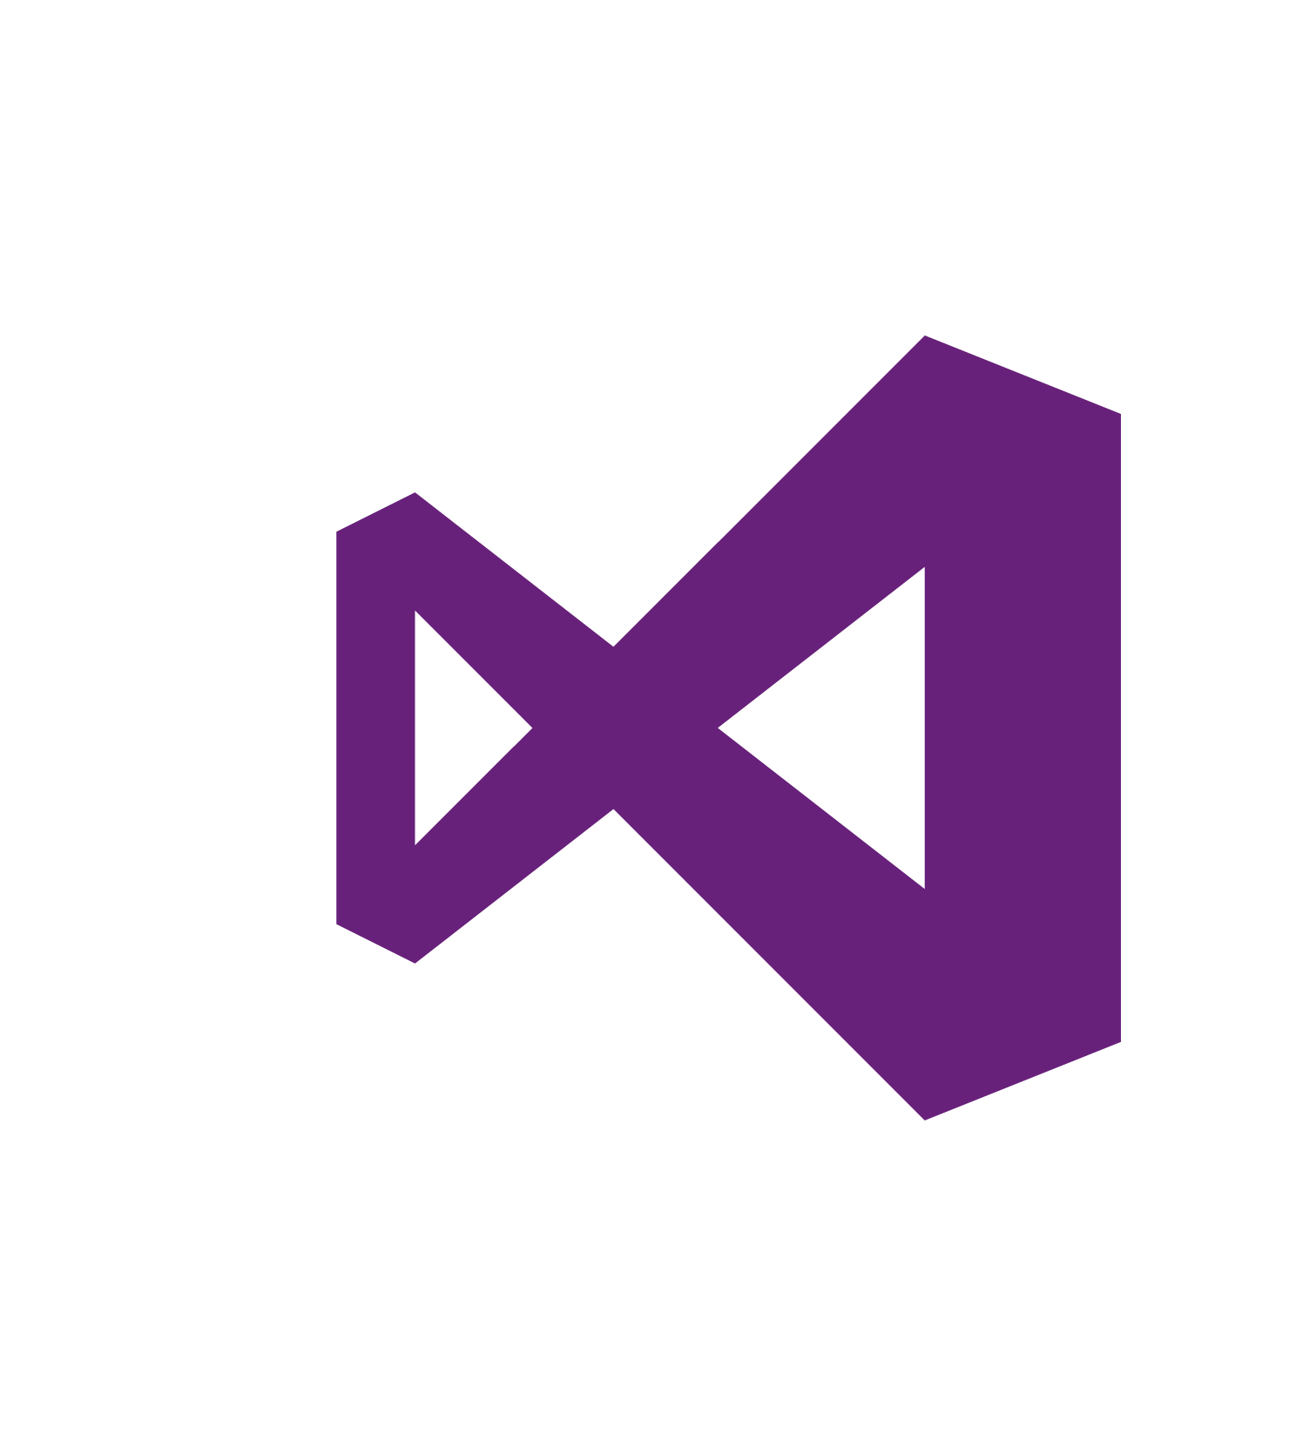

Any Developer, Any App, on Any Platform
Notes:
Talking Points
With the increase and diversity of devices there is an opportunity for developers to reach users where they are.
Also with the power of the cloud, infrastructure and capital expenditures no longer have to be a barrier to creating great applications.
Visual Studio 2015 bridges mobile and the cloud by being the first version built to target mobile-first and cloud-first development.
Cross-platform mobile development, Android, iOS, or Windows
Cross-platform server development, Windows or Linux

Slide 3



Visual Studio for any developer
Code
Team Services
Team Foundation Server
Windows
Linux
iOS
Android
.NET C#
C++
JavaScript
PHP
Python
Node.js
R
Cordova
Unity
Java
Perl

Slide 4
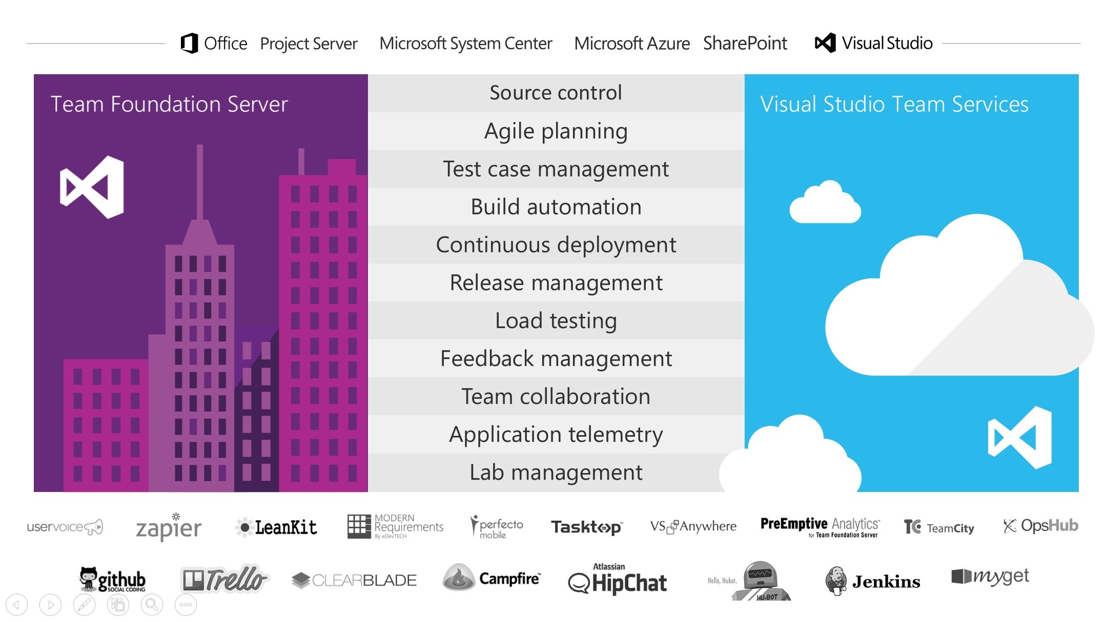

Slide 5
What is DevOps?

Slide 6
“The union of people, process, and products to enable continuous delivery of value to our end users.”
Donovan Brown, MSFT Sr PM

Slide 7
What is DevOps and why do I care?
New to most Windows shops
Adoption is slow – only so many hours in the day, many manual tasks
Has a clear place in the (near) future
Azure Automation DSC
Is a great solution on our platform compared to Puppet/Chef/Ansible
Keep customers on our platform – become/stay relevant in this space.
Benefits are clear
Allows more agility
Resilient to failures
Manageable at scale
Notes:
Set the stage.
PowerShell DSC is not a solution. It’s a tool.
This talk is a shameless plug for AA DSC.
“on our platform” – all of the incumbent configuration management solutions are much stronger with AWS cloud and Linux platform. Their capabilities on Azure / Windows are comparatively weak.
DSC = Desired State Configuration, a PowerShell technology.
Infra/Configuration as Code
Release Management
Continuous Integration and Deployment
Automated Testing
App Performance Monitoring
Configuration Management

Slide 8
Quicker and more frequent automated deployment of software.
Delivery Options
Files + configuration (web deploy, x-copy, custom scripts, etc.)
Packages (MSI, zip, etc.) ← subject of this talk
Larger grain delivery (containers, VM images)
Automate
Modify code → check in to VSTS → build & package → deploy package to repository
Azure Automation DSC “connects” packages with the VMs that need them (via node configurations)
Requires Configuration Management, Infrastructure as Code.
Package Management
Get the right packages to the VM
Chocolatey / Windows Package Management
Notes:
Note the absence of the word “Azure” in the title of this talk. These techniques are generally applicable to any Windows box that can reach its management server. (e.g. your Azure Automation DSC Pull Server)

Slide 9
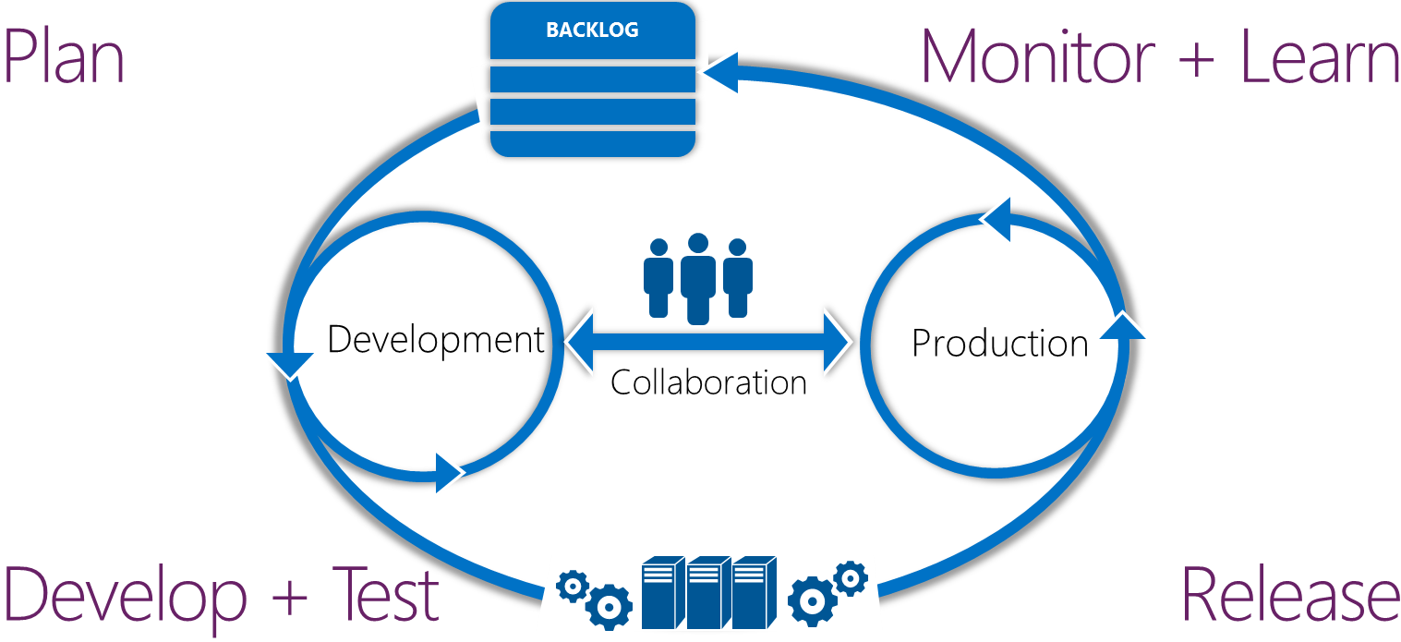
Application lifecycle management
Modern app development
Continuous value delivery and rapid response to change
Notes:
Time: 1-2 minutes
Flow:
There are two important considerations when creating modern applications: continuously delivering value to your customers and rapidly responding to changes in the marketplace.
Delivering at the pace your customers expect is all about decreasing cycle time to incorporate additional feedback loops. A good application lifecycle management solution will help you coordinate your software development efforts from ideation through delivery, and incorporate customer feedback and user insights into your next iteration. This enables you to drive down your cycle times and close your feedback loops; making you better equipped to operate in today’s ever-changing marketplace.
Quotes to look for:
Narrative guidance:
Modern application development boils down to two key concepts. Continuously deliver value to your customers and rapidly respond to changes in the marketplace. Delivering at the pace your customers expect is all about cycle time and feedback loops. With a good application lifecycle management solution, you can coordinate your software development efforts from ideation to delivery to incorporating customer feedback into the next iteration. This will enable you to drive down your cycle times and close your feedback loops; making you better equipped to operate in today’s ever changing marketplace.
Transition to next slide:
This isn’t a new story. ALM has been the norm for software development for the last 10 years. Now let’s take a closer look at some emerging trends in the software development industry.

Slide 10




DevOps
1
4
Plan
Monitor + Learn
Development
Production
2
3
Develop + Test
Release
Notes:
What is DevOps?
As we've gone through the first decade of agile development, we noticed development teams got really efficient at developing software. We also saw that there are two distinct lifecycles. The ALM lifecycle and the Operations lifecycle. They were very different. What we're noticing is there's a convergence of lifecycles into one lifecycle called DevOps. DevOps is more than a technology or a tool set, it’s a mindset that requires cultural evolution. It's around people 1st, then process 2nd, the tooling is there to help facilitate the cultural and process changes you need to make. This is what will make your application lifecycle faster and more predictable.
Why is it important?
DevOps integrates development teams and operations teams in order to improve collaboration, productivity, and be more responsive to business needs. This is accomplished by automating infrastructure, automating workflows, and continuously measuring application performance. Teams work better together and think more alike by breaking down silos and sharing responsibilities. This will Increase the rate of software delivery and improve the time to market from months/weeks to days/hours.
At Microsoft the DevOps investments were making inside of Visual Studio, Visual Studio Online, Team Foundation Server, and Azure reflect on our focus enabling and empowering teams to get great software into the hands of your customers.

Slide 11
Plan
It starts with an idea – and a plan how to turn this idea into reality …
Project starts
Manage work
Develop + Test
1
Track progress
Plan
Notes:
Let’s take a look at some of the work that we’re doing today. I’ll cover this at a very high level now, but much deeper in my session later today.
We can qquickly define, prioritize, and decompose the work for your project. Dashboards and charts provide visibility to your team and stakeholders.
Backlogs to quickly define, prioritize, and decompose the work for your project.
Kanban can be used for each backlog in Visual Studio Online.
Dashboards that provide visibility to your team and stakeholders.
Charts that bring your data to life and make it visible to your team, organization, and stakeholders.

Slide 12
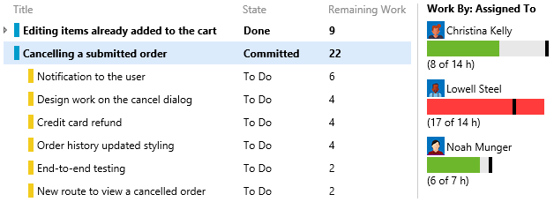
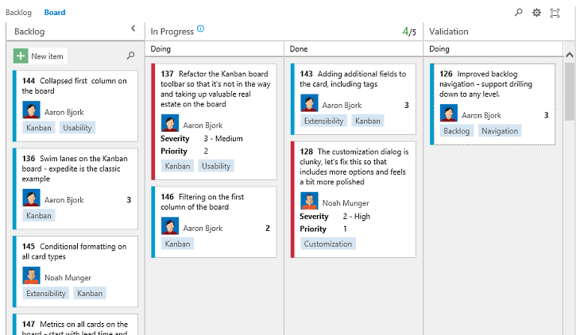
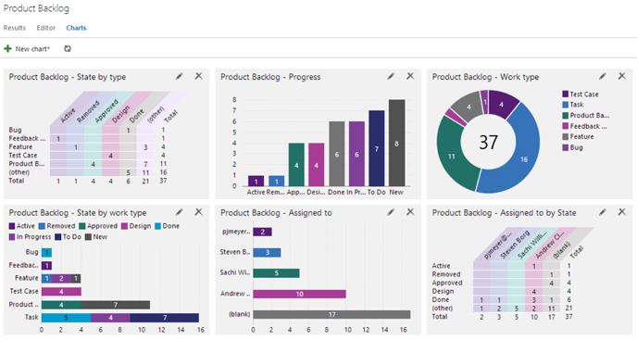

Agile Tools
Backlogs
Quickly define, prioritize, and decompose the work for your project.
Kanban
Each backlog in Visual Studio Online comes with a built-in Kanban board.
Dashboards
Build dashboards that provide visibility to your team and stakeholders.
Charts
Build charts that bring your data to life and make it visible to your team, organization, and stakeholders.

Slide 13
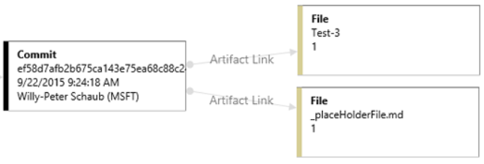
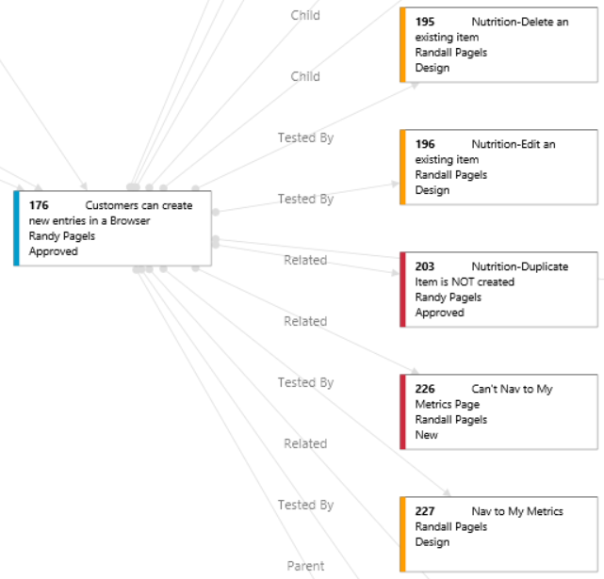
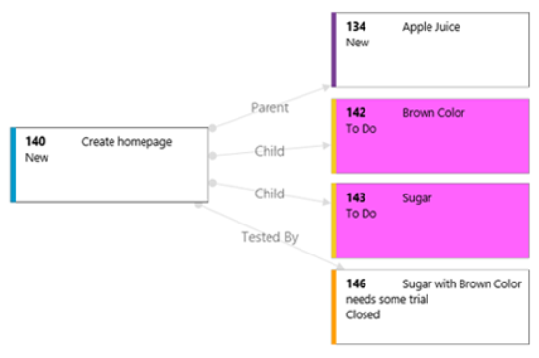
Work Item Visualization
Visualize work item relationships
Visualize relationships between work items from within the work item form
Drill-down in your chart and even visualize commits
Visually see how work items relate to each other
Highlight what's important
Use colors to highlight important work item types within your visualization
Available in the Visual Studio Marketplace

Slide 14
Develop + Test
Once the iteration starts, developers turn great ideas into features …
2
Write Code
Unit Testing
Version Control
Build
Build Verification
Release
Notes:
Our next phase is allowing developers and testers do what they do best, which is creating software.
Once the iteration starts, developers turn great ideas into features.
There are many activities around developing code and keeping the quality very high.
We have developer productivity features from CodeLens to Intellitests

Slide 15
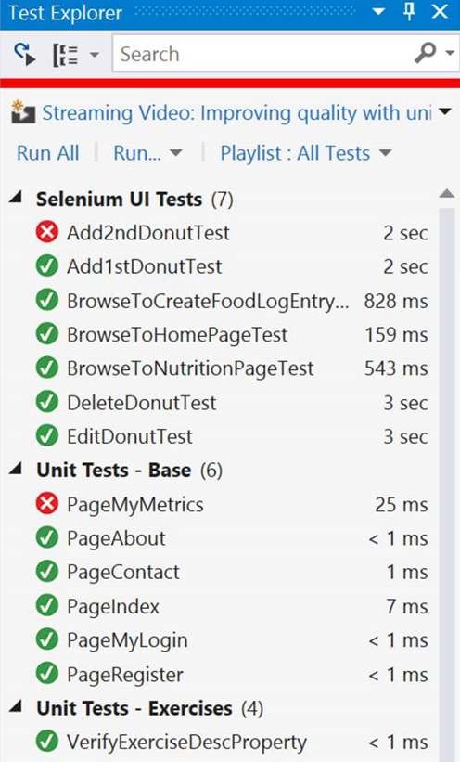
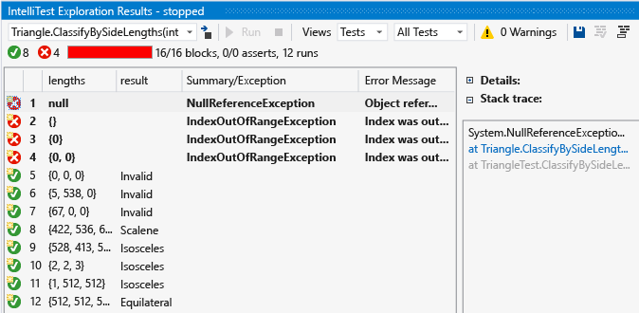
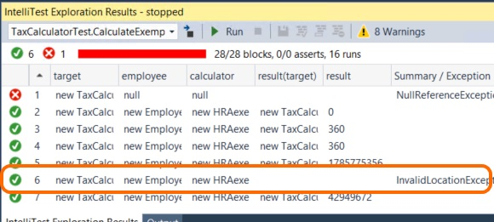
Unit Testing
Test Runner
Tests run in background automatically on each build and supports multiple frameworks:
MS Test, xUnit, nUnit , jUnit, oUnit, Selenium…etc
Deep integration in the IDE with run options
Supports native C++ code
Easy code coverage access for all tests
Intellitest
Generate parameterized unit tests, including setup
Discover edge cases and generate unit tests for all possible code paths
Keep your tests in sync with your code changes, automatically

Slide 16
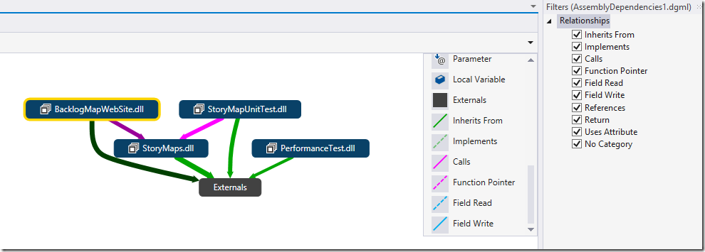
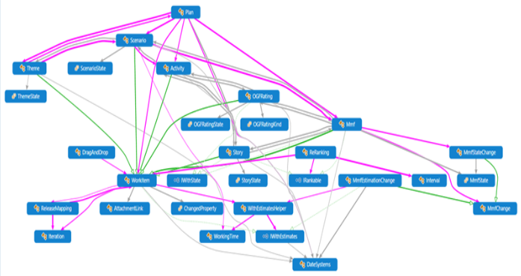
Code Maps
Filter link types on Code maps and dependency graphs
Drag and drop from object browser or class view
Create new diagrams from selected nodes
Create new blank Code Map from the simplified Architecture menu
Faster display and better responsiveness
Less clutter with implicit .NET type dependencies hidden
Filters for code elements as well as dependency links

Slide 17
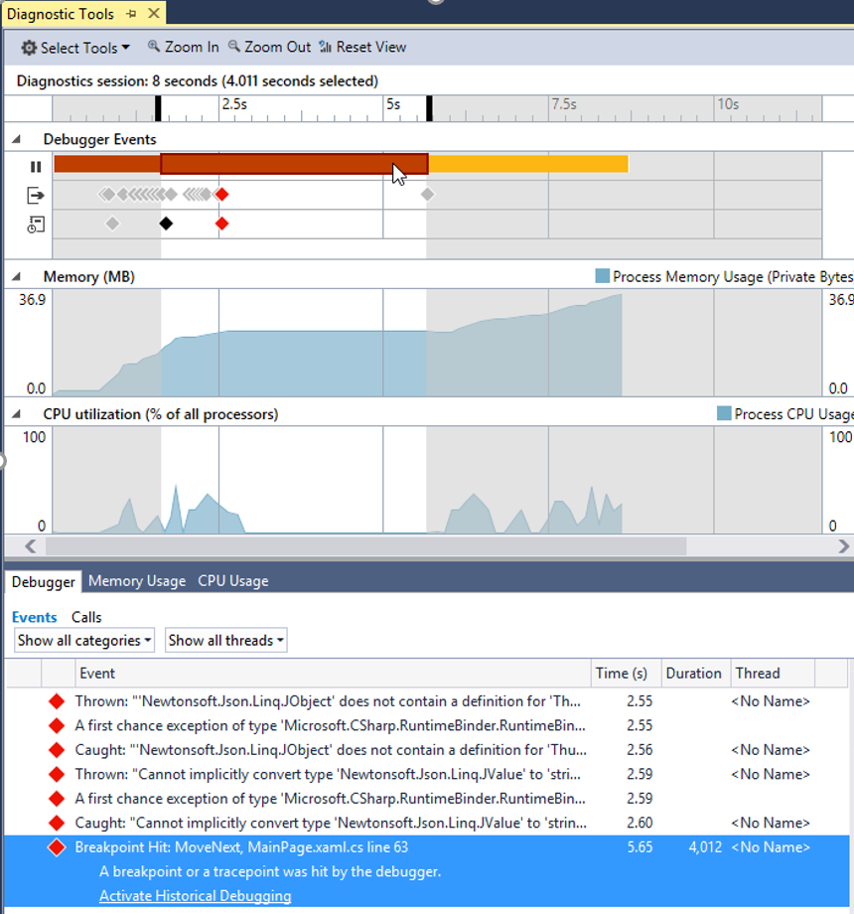
Debugging and Diagnostics Improvements
Diagnostic Tools window
Debugger Events (with IntelliTrace)
See memory Usage, CPU Usage, and more
Notes:
The window appears for the following project types:
Managed WPF, WinForms, Console projects
Native Win32, Console, and MFC projects
ASP.NET 4 using IIS Express
Managed or Native 32-bit Windows Store projects running locally
(The feature doesn’t currently support ASP.NET 5 and IIS, as well as Windows Store projects that are 64-bit, using JavaScript, running on a remote device, or running on a phone.)

Slide 18
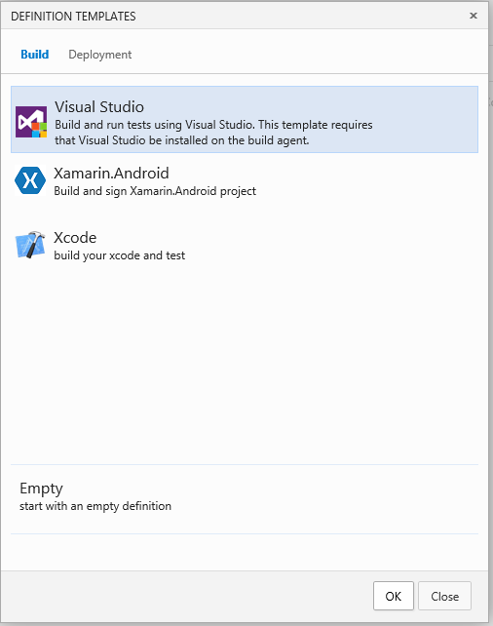
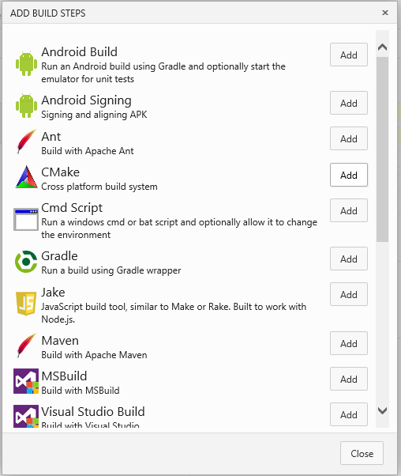
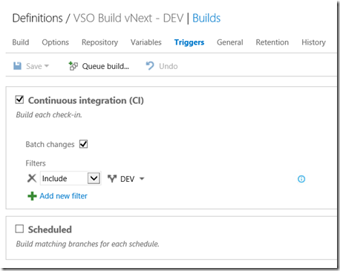
Next generation build
Cross-platform build capabilities
Compile using Visual Studio, Xamarin for Android or Xcode
Variety of build steps for technologies including Ant, CMake, Maven, Xcode Build, Android Build, and more
Get more from the build process
Continuous integration to find build issues earlier
Create your own build definition templates or use community templates from your Git provider
Notes:
Talking Points
The next generation build system will enable teams to more easily create custom build workflows by introducing reusable tasks and leverages a lightweight, web-based authoring environment. This build system will also be capable of building code from external systems such as GitHub by leveraging the REST API’s and service hooks infrastructure available in Visual Studio Online.
Finally, a new cross-platform build agent will allow teams to run builds on non-Windows machines. This makes it possible for the first time to build on Linux machines and for iOS / OSX by running builds on Macs.
Background Information
This will be previewed at BUILD but will not be available until a few weeks afterwards. Depending on when you give this presentation you should check to see if this feature is available.

Slide 19
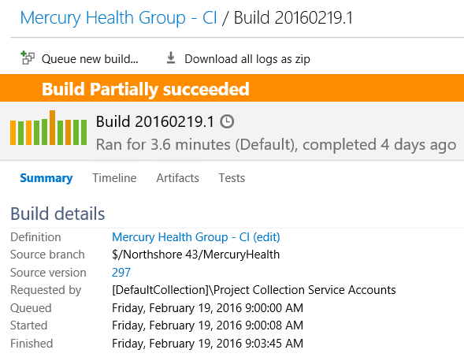
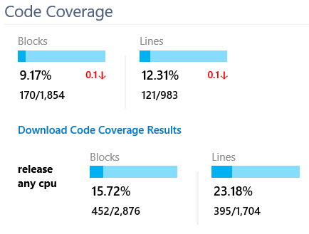
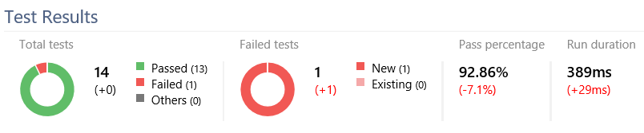
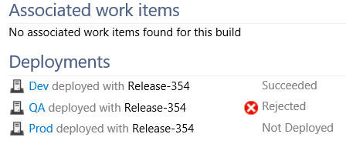
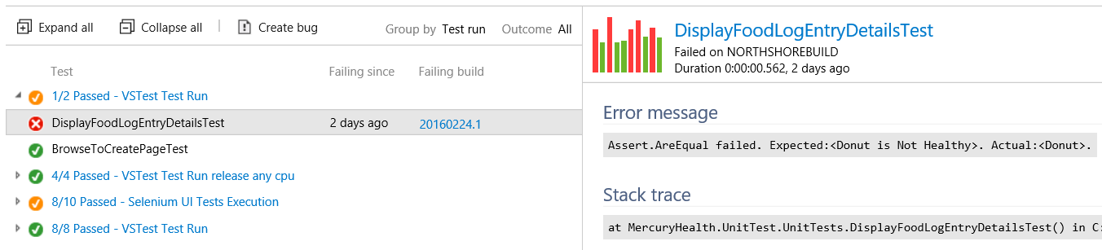
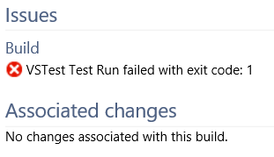
Build Summary Report
The Build Summary lists builds and provides information about associated code changes, associated work items, test results, test issues, test coverage, code churn, deployments, and quality notes for each build
Notes:
Talking Points
The next generation build system will enable teams to more easily create custom build workflows by introducing reusable tasks and leverages a lightweight, web-based authoring environment. This build system will also be capable of building code from external systems such as GitHub by leveraging the REST API’s and service hooks infrastructure available in Visual Studio Online.
Finally, a new cross-platform build agent will allow teams to run builds on non-Windows machines. This makes it possible for the first time to build on Linux machines and for iOS / OSX by running builds on Macs.
Background Information
This will be previewed at BUILD but will not be available until a few weeks afterwards. Depending on when you give this presentation you should check to see if this feature is available.

Slide 20
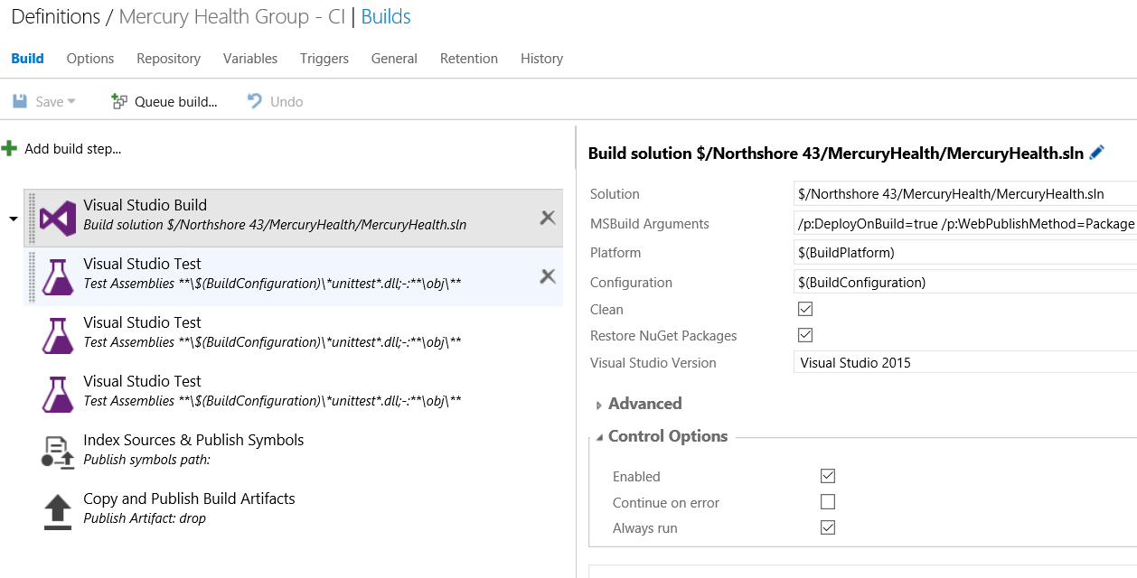

Slide 21
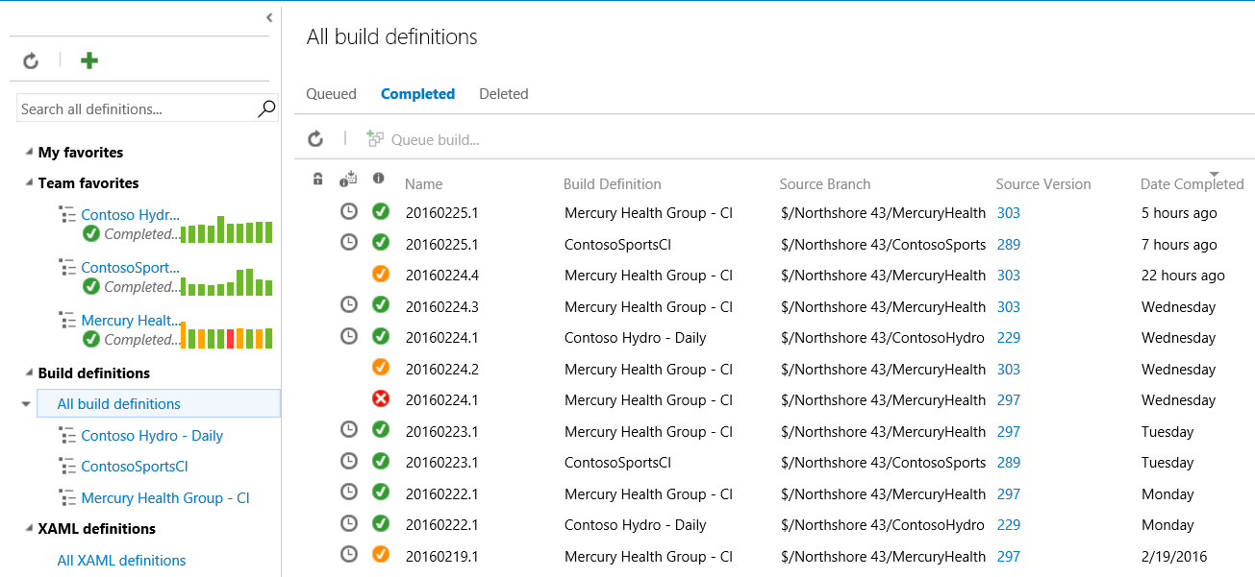

Slide 22
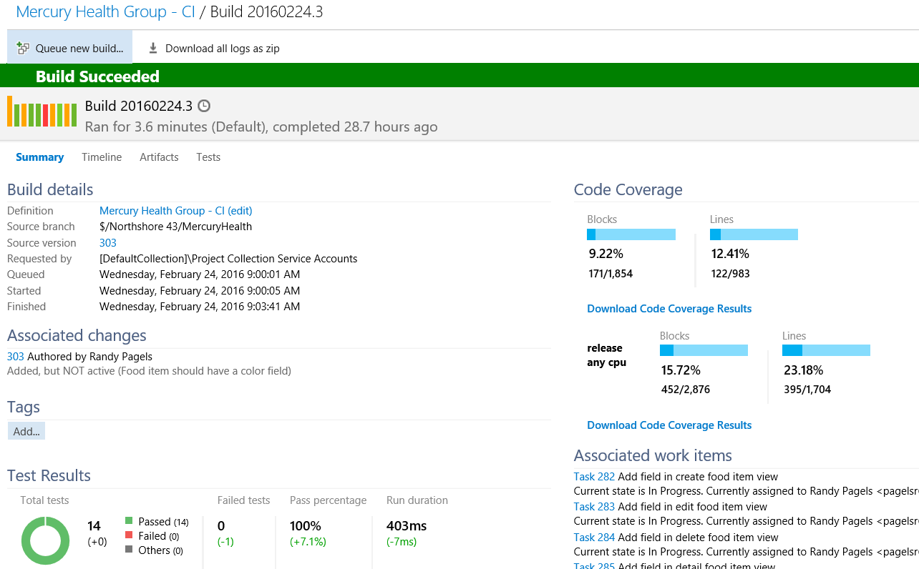
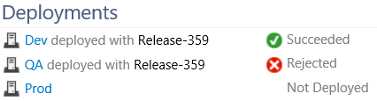

Slide 23
Technical Debt
Symptoms
new value delivered slowly
frequent Bugs
frequent LSIs
change not localized
fear to change
Examples
code analysis issues
duplicate code
code complexity
not enough tests
redundant & flaky tests
architectural spaghetti
Notes:
Symptoms
new value delivered slowly
frequent Bugs
frequent LSIs
change not localized
fear to change
Examples
code analysis issues
duplicate code
code complexity
not enough tests
redundant & flaky tests
architectural spaghetti
Technical debt is the set of problems in a development effort that make forward progress on customer value inefficient. Technical debt saps productivity by making code hard to understand, fragile, difficult to validate, and creates unplanned work that blocks progress. Technical debt is insidious. It starts small and grows over time through rushed changes, lack of context and lack of discipline. Organizations often find that more than 50% of their capacity is sapped by technical debt.

Slide 24


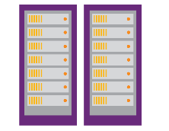
Technical Debt Bottleneck
Makes forward progress on customer value inefficient
Technical debt zaps productivity
Technical makes code hard to understand, fragile, difficult to validate
Technical creates unplanned work that blocks progress
50% of capacity is zapped by technical debt
Usage should determine the next set of priorities and learnings
Requirements
Backlog
… but technical debt slows it down
Availability and performance issues are hard to troubleshoot in this fast-changing world with distributed applications
Development
Production
Collaboration
The agile methodologies are accelerating the construction process
An automated release pipeline is needed to deliver at the pace of development with full traceability
… but technical debt slows it down
… but technical debt slows it down
Notes:
Technical debt is the set of problems in a development effort that make forward progress on customer value inefficient. Technical debt saps productivity by making code hard to understand, fragile, difficult to validate, and creates unplanned work that blocks progress. Technical debt is insidious. It starts small and grows over time through rushed changes, lack of context and lack of discipline. Organizations often find that more than 50% of their capacity is sapped by technical debt.
Examples
code analysis issues
duplicate code
code complexity
not enough tests
redundant & flaky tests
architectural spaghetti

Slide 25


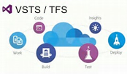
Embrace SonarQube – time to market, rich ecosystem
Understand
What Microsoft has
Technical Debt Dashboard
Technical Debt DataMart
What SonarQube brings
on-prem server
on-prem server
Govern
Measure
Java, JS/html/CSS, Objective C, Android Lint, C/C++, …
IDE
Continuous Integration
VS
Eclipse
IntelliJ
Maven
Jenkins
Prevent & Remediate
…
Web based experience
TFS
VSTS
GitHub
.Net, C++
Source Control
Work Items

Slide 26

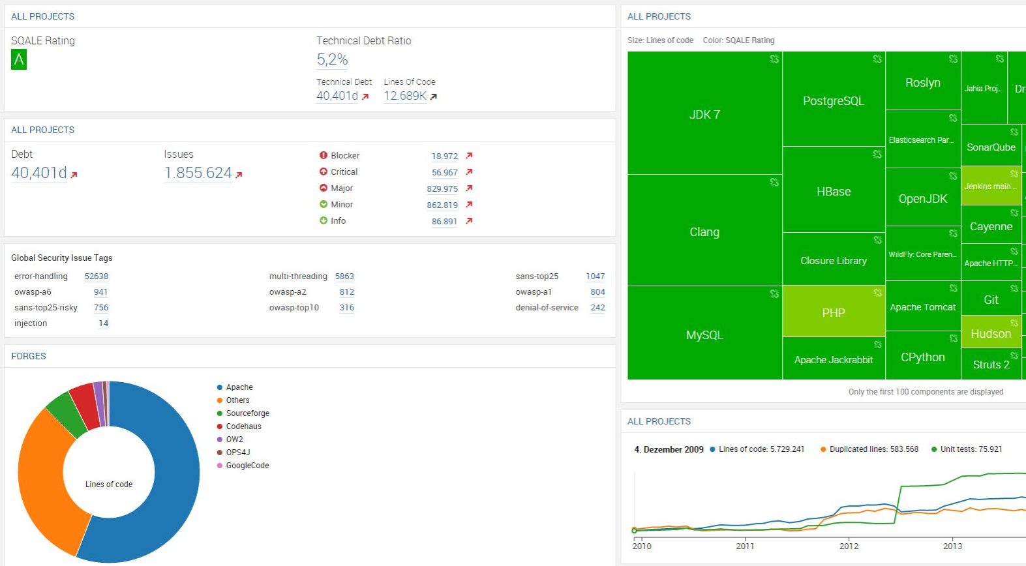
SonarQube Integration
Helps to control technical debt
Build info used for deep analysis and problem prioritization
Open source with paid offering
Popular, de-facto standard
Rich ecosystem
For Java & .NET
Notes:
Symptoms
new value delivered slowly
frequent Bugs
frequent LSIs
change not localized
fear to change
Examples
code analysis issues
duplicate code
code complexity
not enough tests
redundant & flaky tests
architectural spaghetti
Technical debt is the set of problems in a development effort that make forward progress on customer value inefficient. Technical debt saps productivity by making code hard to understand, fragile, difficult to validate, and creates unplanned work that blocks progress. Technical debt is insidious. It starts small and grows over time through rushed changes, lack of context and lack of discipline. Organizations often find that more than 50% of their capacity is sapped by technical debt.

Slide 27

Release
When all tests pass, the build is deployed to testing environments for each stage in the release process
Cloud Load Testing
Integration testing
environment
Staging
environment
3
Monitor + Learn
Automated functional testing environment
Pre-production environment
Notes:
Now that we have our build process done, we have a set of binaries. What we need to do is get to production at this point. There’s usually a few steps to get there. We have to go to Dev, QA, UAT, Pre-Production…etc.
If we’re going to speed up that feedback cycle, we need to be able to ship a lot more quickly. What we want to do is take all the manual steps and automate them.

Slide 28
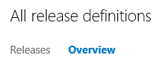
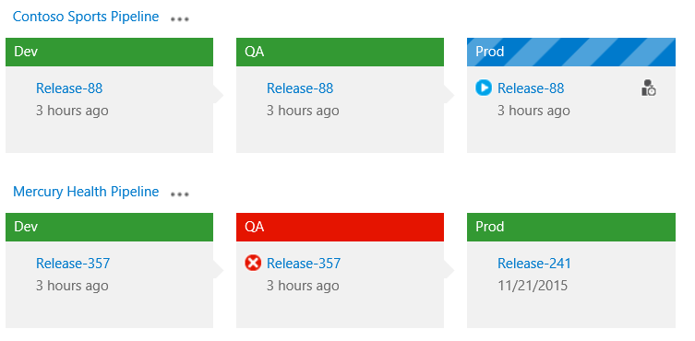
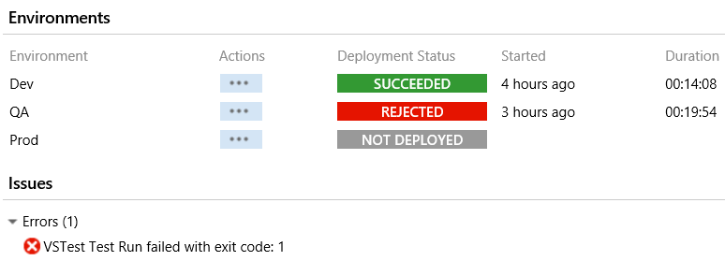
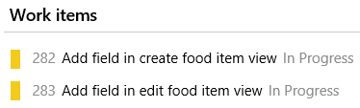
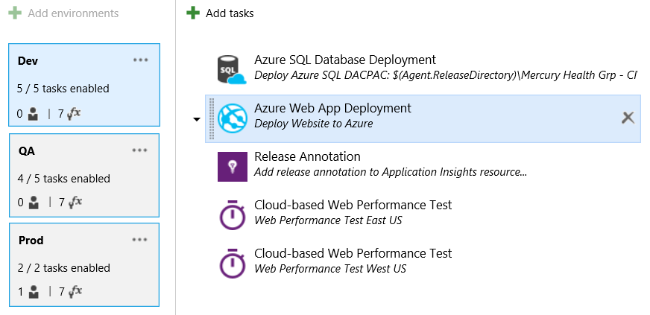
Release management
End-to-end traceability
View change summaries before approving automated releases
Track work items as they deploy to production through change summaries
End-to-end automation
Automate the deployment process to deploy to each environment the same way
Automate approval workflow to reduce delays and coordination issues
Configuration as code
Set the desired state configuration (DSC) in code for readability and to execute in PowerShell
Deploy consistently
Deploy applications on-premises or in the cloud
Use templates for consistency or to trigger a deployment from a build
Notes:
Talking Points
Release management capabilities in Visual Studio provide the automation and traceability to release frequently.
Background Information
Work-item tracking with Release Management: http://blogs.msdn.com/b/visualstudioalm/archive/2014/08/05/work-items-tracking-using-release-management.aspx
Release management: http://www.visualstudio.com/explore/release-management-vs
Release management VSO service: http://blogs.msdn.com/b/visualstudioalm/archive/2014/11/12/using-release-management-vso-service-to-manage-releases.aspx

Slide 29
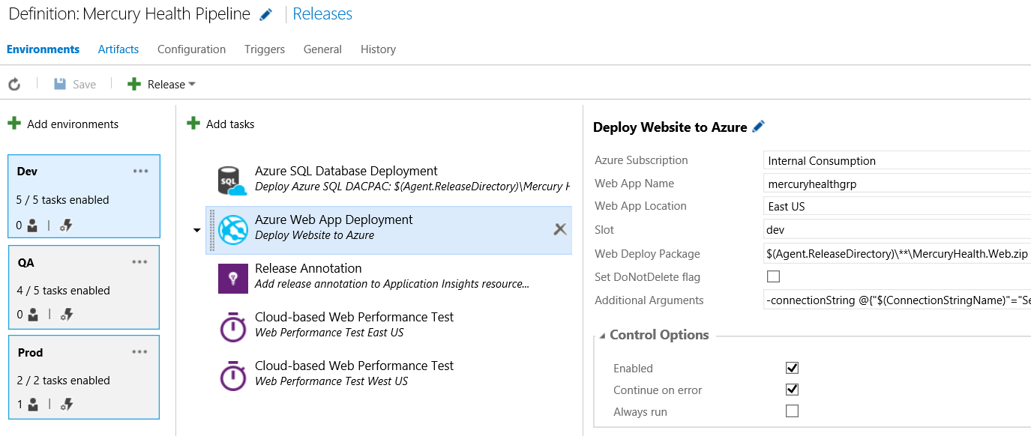
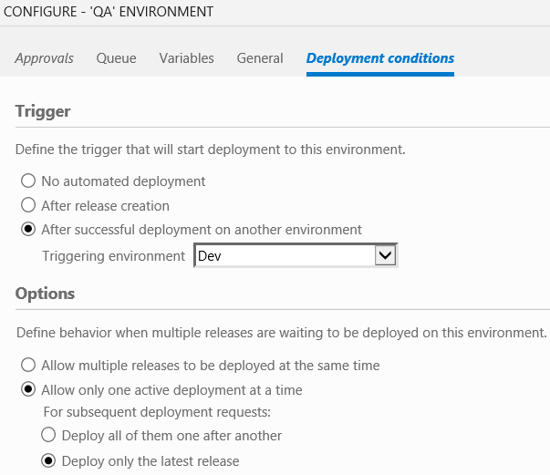
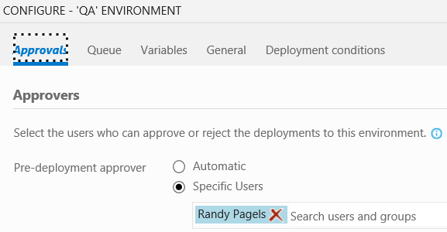
Release Pipeline

Slide 30
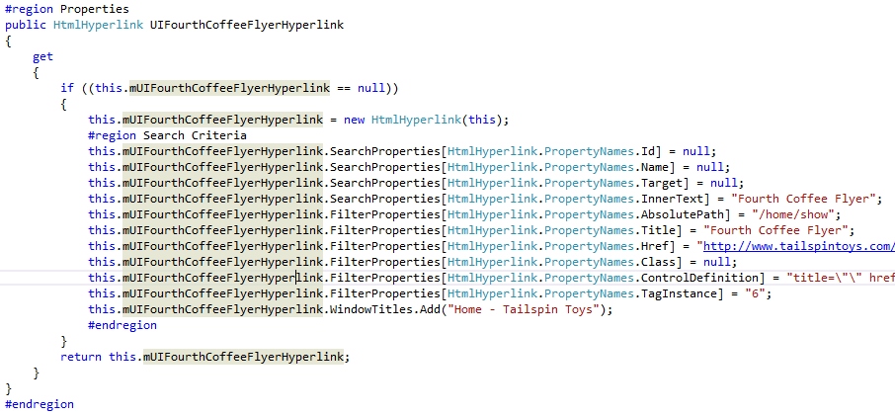

UI Automation
Coded UI
Coded UI tests provide a way to create fully automated tests to validate the functionality and behavior of your application’s user interface
Selenium
Selenium automates browsers. Primarily, it is for automating web applications for testing purposes, but is not limited to just that

Slide 31
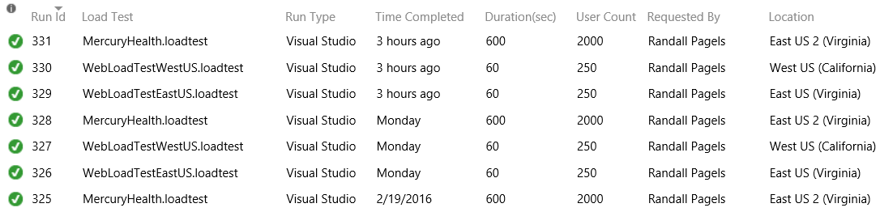
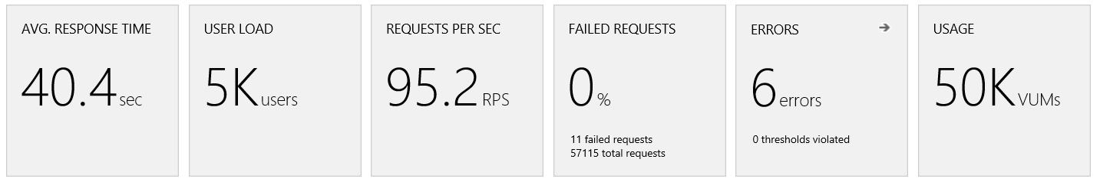
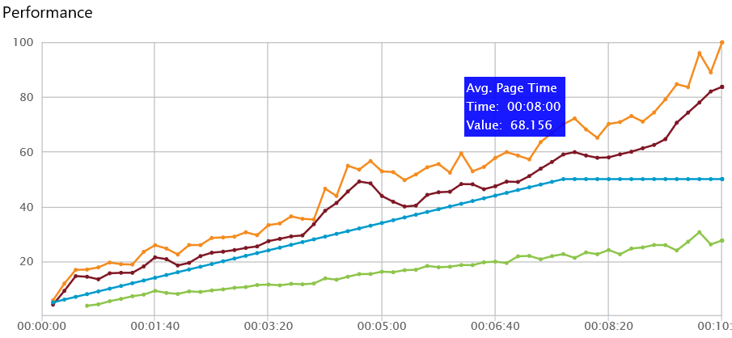
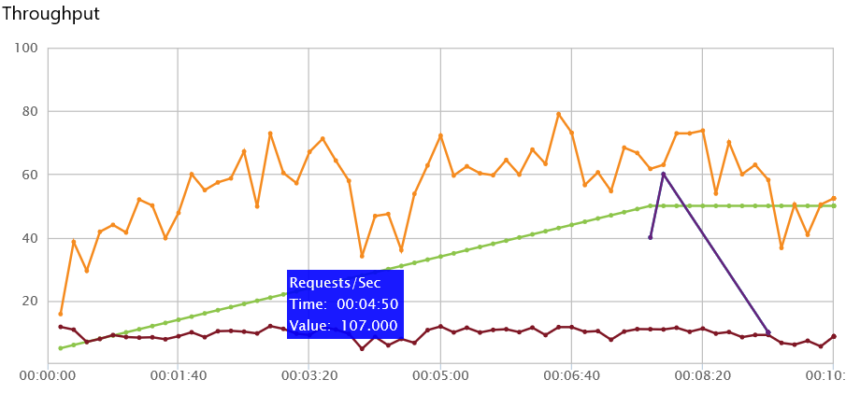

Cloud Based Load Tests
Performance test your code with hundreds of thousands of users using Visual Studio Team Services
Load test web sites, apps and APIs
Trace and exception logging
Deep reporting and diagnostics
Generate load from multiple regions worldwide
20,000 virtual user minutes FREE every month
Apache JMeter Test Support

Slide 32
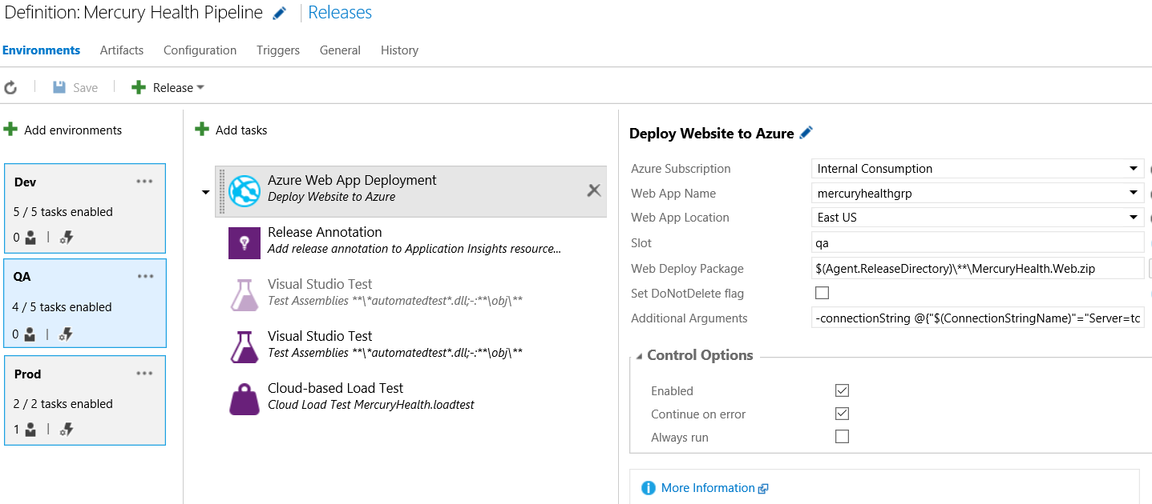

Slide 33
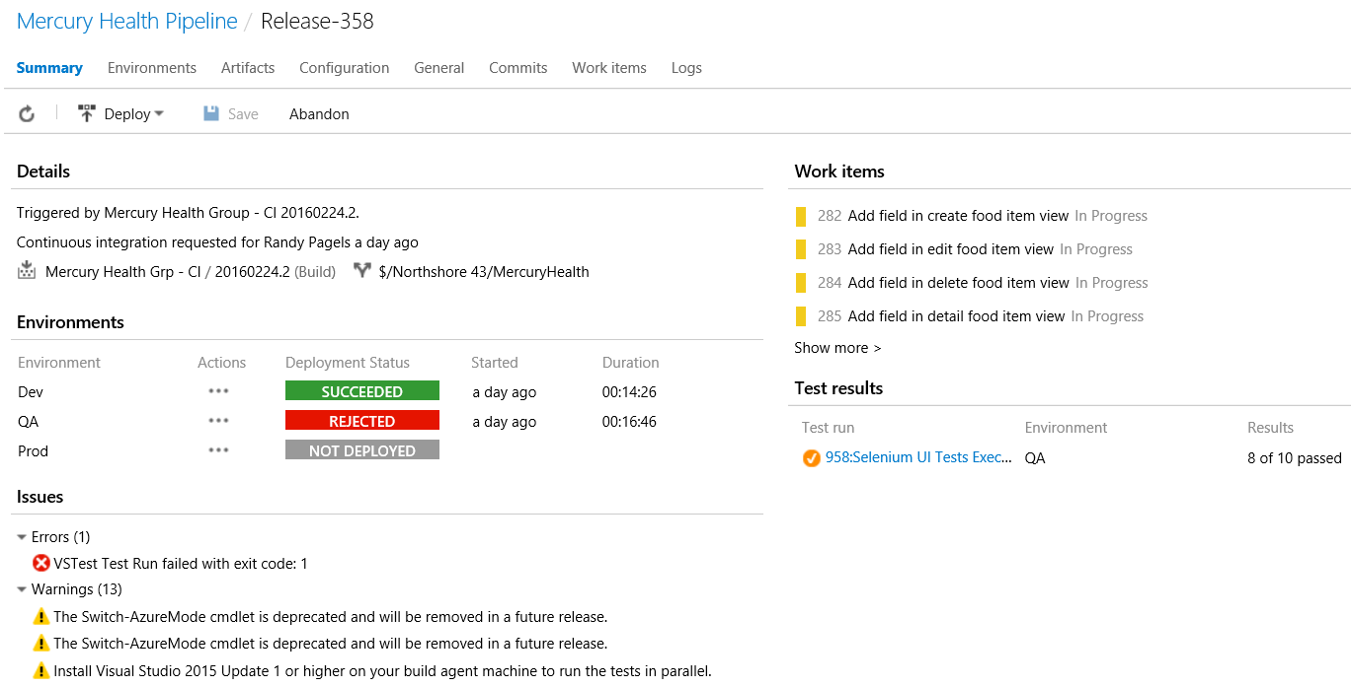

Slide 34
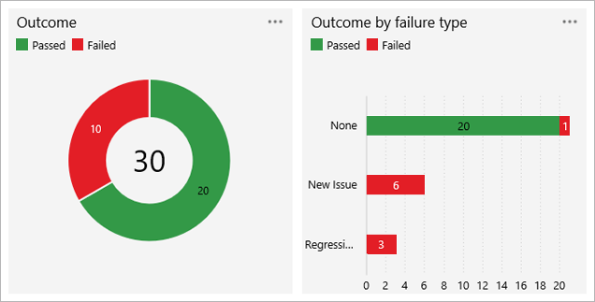
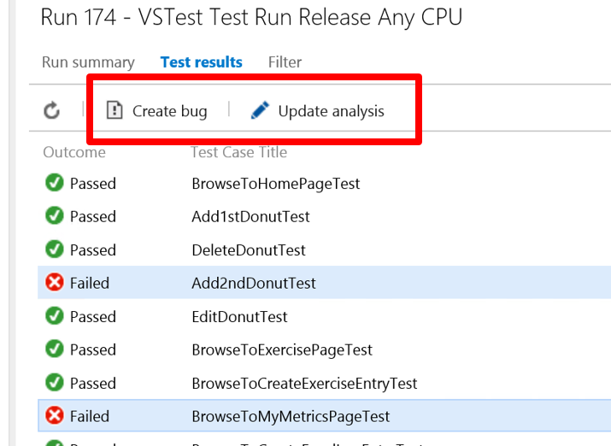
Test Run Hub
Test Run Summary
Contains the results of the test runs
List shows which ones have completed successfully, need investigation, or completed the investigation
Great starting point for analyzing the results
Run visualizations
Understand the outcome of the test run

Slide 35
Monitor + Learn
Learn and understand how users use your app, how it reacts and quickly fix issues and bugs
Plan the next iteration
Feedback
Monitor
4
Notes:
Finally, we move into the last phase. Now that we have moved our builds into production one of the big challenges that we have in DevOps is making sure that we not only can release quickly, but we can learn quickly. This allows us to build the right product for our customers.

Slide 36
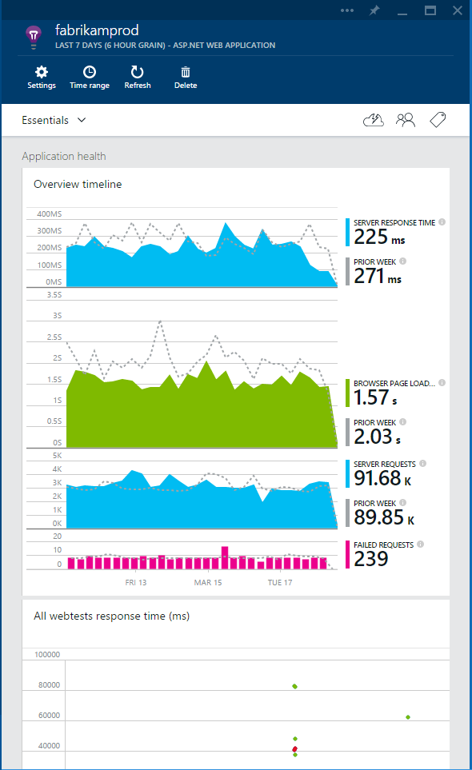
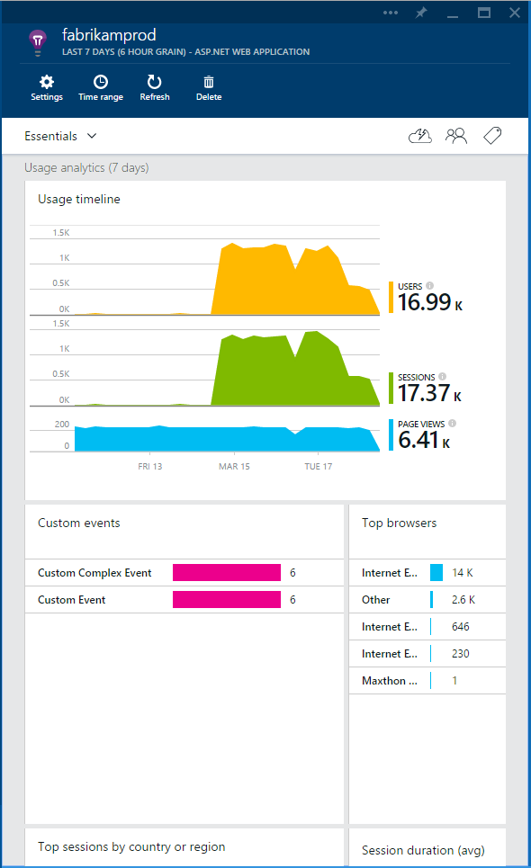



Visual Studio Application Insights
Detect issues, diagnose crashes and track usage in your web and mobile apps
Announcing Public Preview on Azure Preview Portal
Monitor ASP.NET, Java and other web apps and services
Support for Android, iOS and Windows mobile apps
Pricing details available now including free tier
Check it out!
http://azure.microsoft.com/en-us/services/application-insights

Slide 37


Application insights
Measure
Add application insights to your application when you create your project in Visual Studio or add it to an existing project
See telemetry data while debugging
Learn
Explore metrics to see how your application is performing over time
Usage insights give you insight into how your users are spending their time so you can make the right prioritizations
Set alerts to be notified about issues
Notes:
Talking Points
Applications Insights is “Public Preview” so you can use it learn how your app behaves with real usage.
Background Information
http://azure.microsoft.com/en-us/documentation/articles/app-insights-start-monitoring-app-health-usage/#add
Monitoring web applications: http://azure.microsoft.com/en-us/documentation/articles/app-insights-web-monitor-performance/

Slide 38



Application insights
Cross-platform support
Get telemetry data from ASP.NET iOS, Android, Windows, Linux, Java, and more for a comprehensive perspective
Supports a variety of OSS technologies including Node.JS, Python, Ruby, PHP, and more
Get crash analytics on iOS and Android
Extend your insights
Add custom metrics and events to track and analyze activity
Export data to Azure blob storage to integrate and analyze with other data
Proactive Detection
Proactive Detection uses machine learning and data mining to help you find issues
Build Annotations
Notes:
Talking Points
Application Insights is not just for your Windows and Azure apps but also has cross-platform support for iOS and Android as well.
You also have the flexibility to add your own customized metrics or export the data to integrate with other data sources.
Background Information
https://microsoft.sharepoint.com/teams/dtms/_layouts/15/WopiFrame.aspx?sourcedoc={5802DA69-7266-4768-9B37-F07A4F812228}&file=(V3)%20AI%20Customer%20Deck.pptx&action=default

Slide 39

Build Annotations

Slide 40


Power BI Integration
Gain understanding and insights into projects in VSTS
Analytical capabilities of Visual Studio Team Services using Power BI
Easily visualize data and gain insights not previously possible
Identify gaps and issues
Understanding data is the key to making insightful business decisions
Fix those issues and monitoring progress
Use innovative features in Power BI
Full natural language query capability
“How many pull requests per day? Per week?”
Notes:
Talking Points
This is the first in a wave of additions to the analytical capabilities of Visual Studio Online using Power BI to easily visualize data and gain insights not previously possible.
Understanding data is the key to making insightful business decisions, identifying gaps and issues, fixing those issues and monitoring progress.
Background Information
http://blogs.msdn.com/b/visualstudioalm/archive/2015/05/04/gain-understanding-and-insights-into-projects-in-visual-studio-online-with-power-bi.aspx

Slide 41
Automate Everything

Slide 42


Azure App Service
.NET, Java, Node.js, PHP, Python
Auto OS patching
Auto scale/built in load balancing
Integration with existing apps
Continuous deployment
Web Apps
Mobile Apps
Web apps that scale with your business
Build Mobile apps for any device
LOGIC Apps
Api Apps
Automate business process across SaaS and on-premises
Easily build and consume APIs in the cloud
Notes:
App Service has everything you need to build apps that target both web and mobile clients from a single app back-end.
Using API Apps, you can connect your app to dozens of popular services like Office 365 and salesforce.com in minutes, and integrate your own APIs so they can be used within any app.
And finally with Logic Apps, you can automate business processes using a simple no-code experience.

Slide 43

Azure Web Apps: Cloud Deployment Slots
http://mercuryhealthgrp.azurewebsites.net/
http://mercuryhealthgrp-dev.azurewebsites.net/
http://mercuryhealthgrp-qa.azurewebsites.net/
Benefits of deployment slots
Deployment slot will carry the name of the Azure Web App + the name of the slot
Swap content and configurations
Warm up the new site, no cold start penalties
Validate changes in staging
Root Cause Analysis
Swap contents back immediately
Notes:
Live web apps with their own hostnames
Swap content and configurations elements between two deployment slots
Validate changes in a staging slot before swapping it with the production slot
Swap contents back immediately. if changes are not as you expected
Root Cause Analysis. Diagnosis production issues after fixes are made in the staging slot

Slide 44








Azure Web Apps: Web Jobs
Light-weight CPU Intensive Tasks
run.cmd, run.bat
run.exe
run.ps1
run.sh
run.php
run.py
run.js
Job Type:
On-Demand, Scheduled, Continuous
Scale:
Singleton, Multi-instance
WebJobs SDK Feature:
BlobTrigger, TableTrigger, QueueTrigger, ServicebusTrigger
Deployment:
Portal, Visual Studio, CLI, Git

Slide 45

Web App: DevOps Workflow
Code Repository
Team Build
Deploy to Slot
UI & Load Testing
Swap Slots
Visual Studio
Eclipse / XCode
Azure
Application Insights and Hockey App
Notes:
Why Azure App Service builds fully managed DevOps solutions: so you can manage business goals rather than infrastructure.

Slide 46
DEMO
Notes:
DevOps
Continuous Integration (Build)
Continuous Deployment (Release Management)
Continuous Testing (Test Hub)
End-to-End Demo "A Day in the Life of a Developer"
.Net / Java / Windows / Linux

Slide 47

www.teamsystemcafe.net/resources

Slide 48


Next Steps
Create a Visual Studio Online account
Try the Release Management Service & Application Insights
visualstudio.com
Download Visual Studio 2015
Use your Visual Studio Online & Azure benefits
msdn.microsoft.com
Try App Service: Web Apps today
tryappservice.azure.com
DevOps and Application Lifecycle Management
msdn.microsoft.com/en-us/library/fda2bad5.aspx
Microsoft’s DevOps Journey
stories.visualstudio.com/devops

Slide 49
Miscellaneous

Slide 52






Access to Azure
What can you do with $100 in Azure?
All MSDN subscribers have access to $50 to $150 monthly Azure credit
Use all your MSDN software benefits in Azure for Dev/Test
Spin up Virtual Machines, Websites, Databases, etc.
3 VMs for 16 hours a day
80 VMs for 20 hour load test
Up to 500 web sites plus SQL DB

Slide 53

Azure Automation
Automation as a Service
Think Orchestrator or Azure Pack Service Automation, but in Azure
Automate repetitive or long-running processes
Script Authoring Environment
Uses PowerShell Workflows
Combination of PowerShell 4.0 and WF
Uses Integration Modules, very similar to PowerShell Modules
Scheduling and Monitoring
Execute scripts on a schedule
Review execution status on a dashboard

Slide 55
.Net Walkthrough

Slide 57
Java Walkthrough

Slide 58


Slide 59


Slide 60



Slide 61


Slide 62


Slide 63



Slide 64



